Slide 1
Inductive & Deductive

Slide 2
Task 1: Inductive and Deductive Reasoning
Decide whether inductive or deductive reasoning was used to draw each conclusion:
1. I’ve never met a golden retriever with a nasty disposition. I bet there aren’t any.
This Photo by Unknown Author is licensed under CC BY-SA

Slide 3
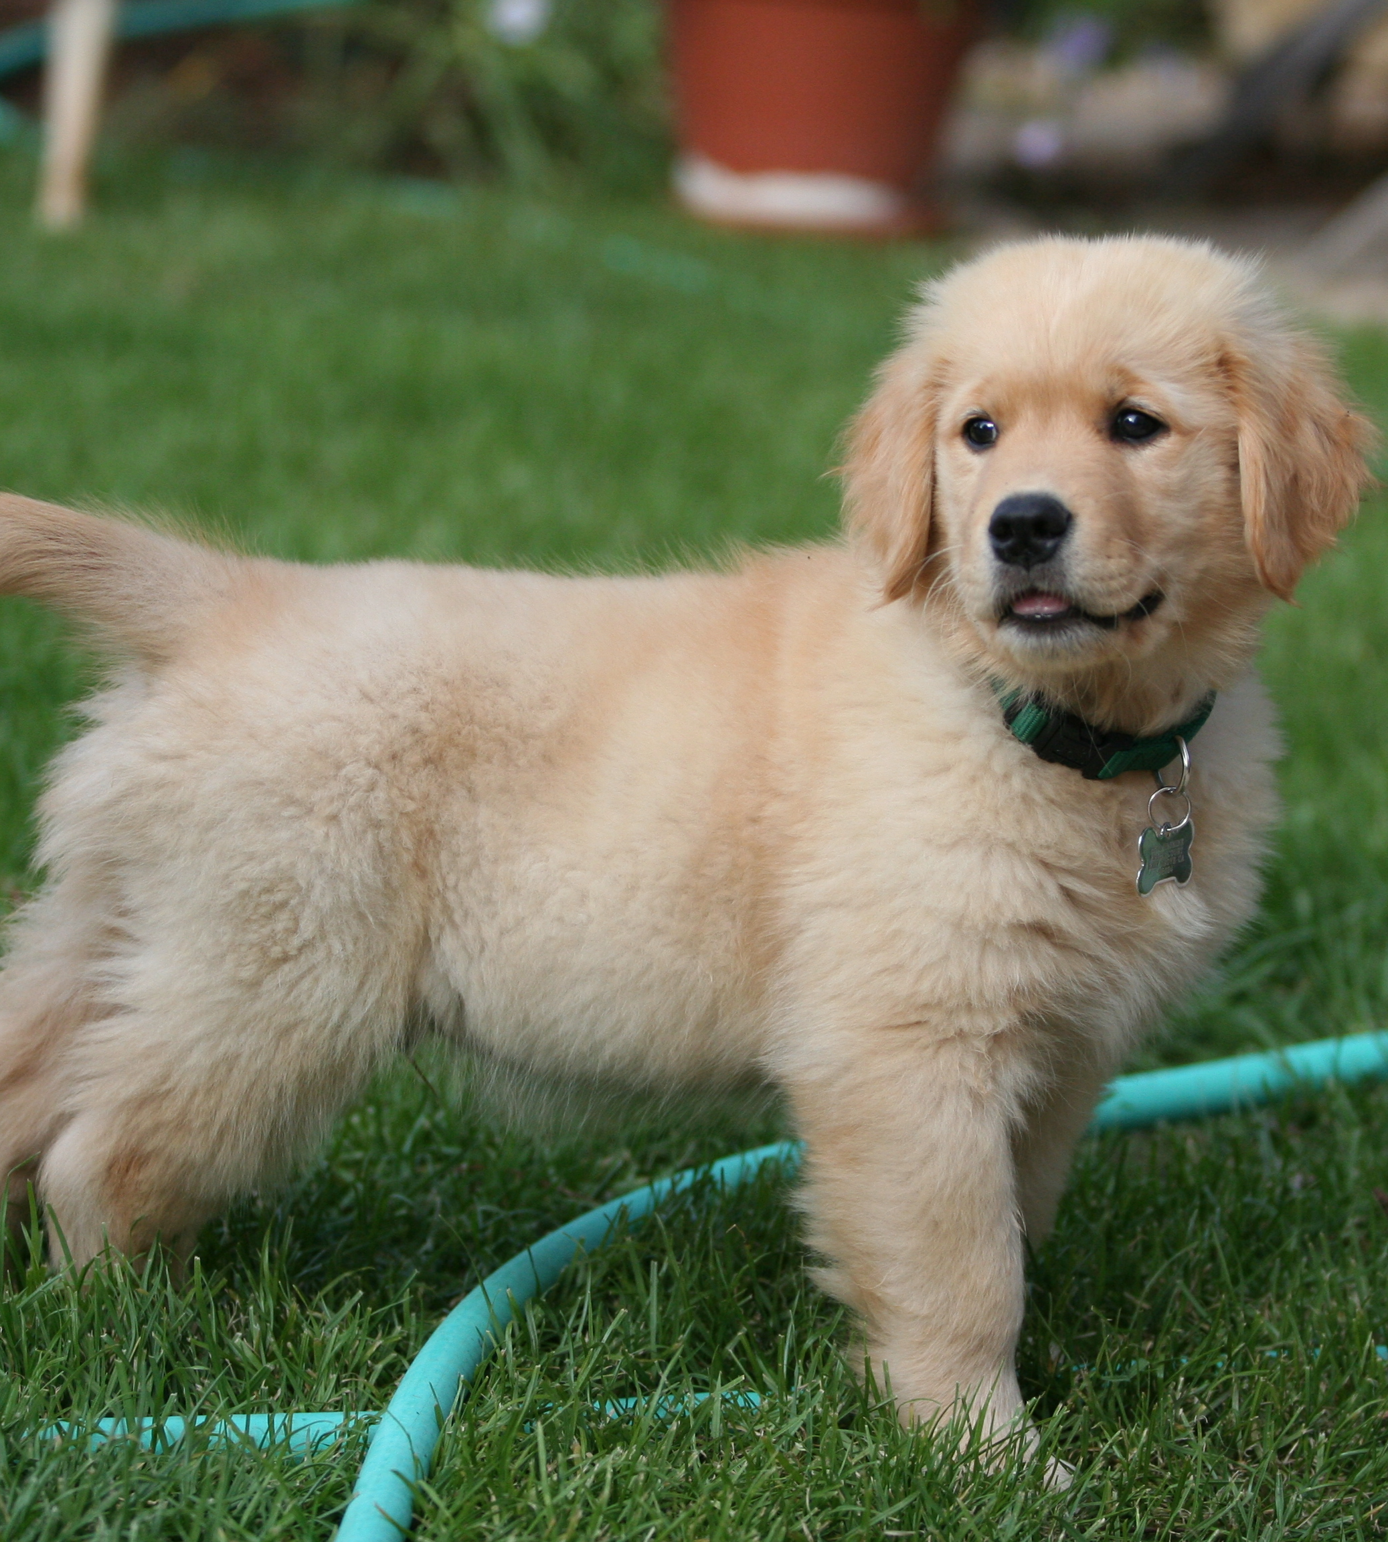
Task 1: Inductive and Deductive Reasoning
Decide whether inductive or deductive reasoning was used to draw each conclusion:
1. I’ve never met a golden retriever with a nasty disposition. I bet there aren’t any.
INDUCTIVE
This Photo by Unknown Author is licensed under CC BY-SA

Slide 4
Task 1: Inductive and Deductive Reasoning
Decide whether inductive or deductive reasoning was used to draw each conclusion:
2. An apple a day keeps the doctor away. I eat an apple every day, so Dr. Phil has never come to my house.

Slide 5
Task 1: Inductive and Deductive Reasoning
Decide whether inductive or deductive reasoning was used to draw each conclusion:
2. An apple a day keeps the doctor away. I eat an apple every day, so Dr. Phil has never come to my house.
DEDUCTIVE

Slide 6
Task 1: Inductive and Deductive Reasoning
Decide whether inductive or deductive reasoning was used to draw each conclusion:
3. Today is Friday, so it will be Monday in 3 days.

Slide 7
Task 1: Inductive and Deductive Reasoning
Decide whether inductive or deductive reasoning was used to draw each conclusion:
3. Today is Friday, so it will be Monday in 3 days.
DEDUCTIVE

Slide 8
Applications of Inductive & Deductive Reasoning
The last four congressional representatives from this district were all Republicans. I don’t know why the Democratic candidate is even bothering to run this year.

Slide 9
Applications of Inductive & Deductive Reasoning
The last four congressional representatives from this district were all Republicans. I don’t know why the Democratic candidate is even bothering to run this year.
INDUCTIVE REASONING, the person assumes the Republican will win based on the previous years.

Slide 10
Applications of Inductive & Deductive Reasoning
Working as a nurse in a hospital requires at least a two-year degree in this state, so when I was in the emergency room last week, I asked the nurse where he went to college.

Slide 11
Applications of Inductive & Deductive Reasoning
Working as a nurse in a hospital requires at least a two-year degree in this state, so when I was in the emergency room last week, I asked the nurse where he went to college.
DEDUCTIVE REASONING because it is based on the rule of all nurses

Slide 12
Applications of Inductive & Deductive Reasoning
Experts say that opening email attachments that come from unknown senders is the easiest way to get a virus on your computer. Shauna constant opens attachments from people she doesn’t know, so she’ll probably end up with a virus on her system.

Slide 13
Applications of Inductive & Deductive Reasoning
Experts say that opening email attachments that come from unknown senders is the easiest way to get a virus on your computer. Shauna constant opens attachments from people she doesn’t know, so she’ll probably end up with a virus on her system.
DEDUCTIVE REASONING because It is based on a rule about virus risk.

Slide 14
Applications of Inductive & Deductive Reasoning
Every time Beth sold back her textbooks, she got about 10% of what she paid for them; so this semester she realized it wouldn’t be worth the effort to sell back her books at all.

Slide 15
Applications of Inductive & Deductive Reasoning
Every time Beth sold back her textbooks, she got about 10% of what she paid for them; so this semester she realized it wouldn’t be worth the effort to sell back her books at all.
INDUCTIVE REASONING because it is based on previous experiences.

